Slide 1


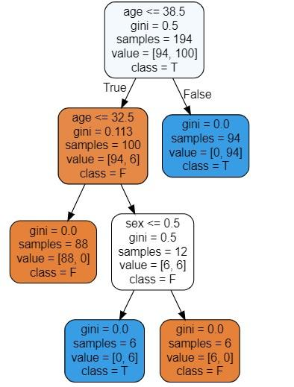

Impact of Machine Learning in Healthcare
Highlights
Machine learning has a plethora of possibilities to give in the healthcare field.
Supervised learning can help with tracking COVID-19 cases.
Trained Decision Trees can help predict Cancer risk amongst patients.
Author 1; Author 2; Author 3
Background
Machine learning in healthcare can have very positive impacts on machine learning. The biggest one is that machine learning algorithms are designed to learn large data sets and with patients’ files. This capability can aid in developing a precise treatment plan by simplifying the search for solutions to a lot of medical cases.
Data Preparation
Examples of Machine Learning in Healthcare:
Clinical decision support systems
Smart recordkeeping
Machine learning in medical imaging
Robotic surgery
Behavior adjustments
Predictive approach to treatment
Drug discovery and production
Infectious disease outbreak predictions
Clinical research
Case Study: Supervised Learning - Decision Tree
Supervised learning is a subcategory in machine learning. It uses datasets that are labeled to train algorithms to classify data or predict outcomes accurately. When it received more information, the data is adjusted, weighted, and fitted appropriately.
A decision tree is a model used to make decisions by splitting data into branches based on the values of input features. Each split represents a decision, leading to a final prediction at the end of each branch. The figure below illustrates the conceptual layout for a Decision Tree.
Machine learning has a plethora of possibilities to give in the healthcare field. As you can see, healthcare means is progressing bit by bit to better care for and aid their patients effectively and with good results.

